Slide 1

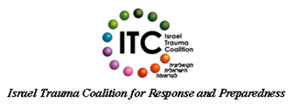
European Network
for
Psychosocial Crisis Management –
Assisting Disabled in Case of Disaster (EUNAD)
Status report

Slide 2







ITC’S Mission
CSPC
Amcha
The mission of the Israel Trauma Coalition (ITC) is to Create continuum of care, response and preparedness, by leveraging diverse resources to initiate, prioritize and optimize services. The ITC provides a comprehensive view of the trauma field, whilst working towards strengthening community resilience and ensuring national emergency preparedness
Natal
Eran
Selah
Hadassah Hospital
Loewenstein Hospital

Slide 3
Scope of ITC Activities
Government level Policy Development
Strengthening Communities: City-wide Models, Planning
Direct Care:
Individuals, Families, Neighborhoods
Team Support: Training, Supervision, Helping the Helper
Notes:
הסקת מסקנות בעקבות לבנון השנייה:
הוספת נדבך של proactive mode נוסף על טיפול ישיר והכשרות מתוך הבנה שניתן לצמצם את נזקי הטראומה ובכך לחסוך משאבים רבים
השמת משקל רב על חיזוק החוסן של הקהילה מתוך ההבנה שכל קהילה צריכה להתבסס על משאביה המקומיים במצבי חירום.
הובלת מהלך להעלאת חשיבות ההכנה לחירום בקרב הסקטור הציבורי בדגש על משרדי הממשלה
בניית מודל מרכזי החוסן

Slide 4


Team Support: Training, Supervision, Helping the Helper
Targeted audience Caregivers
Elderly
New Immigrants
Special needs population
Children
Volunteers
Education System
Clinical care (therapists, psychologists, Social workers)
First responders
Hospitals
Training for care takers of hearing and sight impaired
Emergency preparedness of institutions for hearing and sight impaired
Psycho-education
Training for Social services
Training for First responders

Slide 5
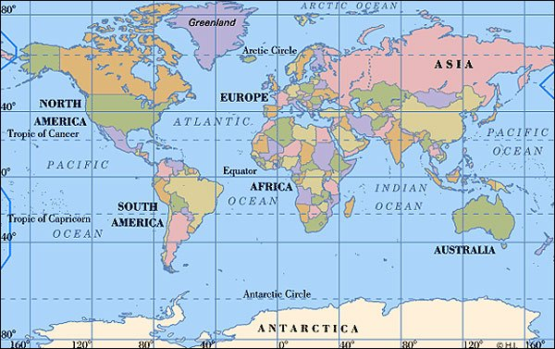
ITC-International Aid
Beslan
Chechnya
Boston
New Orleans
New York
Japan
Haiti
Sri Lanka
Toulouse
Mumbai

Slide 6

Signs in Emergency
A conversation manual
Communicating with hearing impaired people in sign language in times of crisis
Hebrew
Arabic
Russian

Slide 7
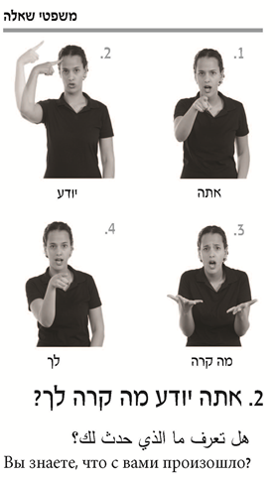
Questions
Do you
Know what
Happened
to you?

Slide 8
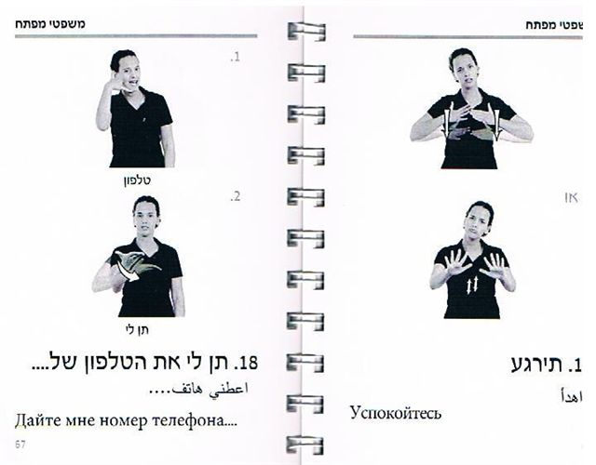
Key sentences
Give me a phone number for….
Relax

Slide 9
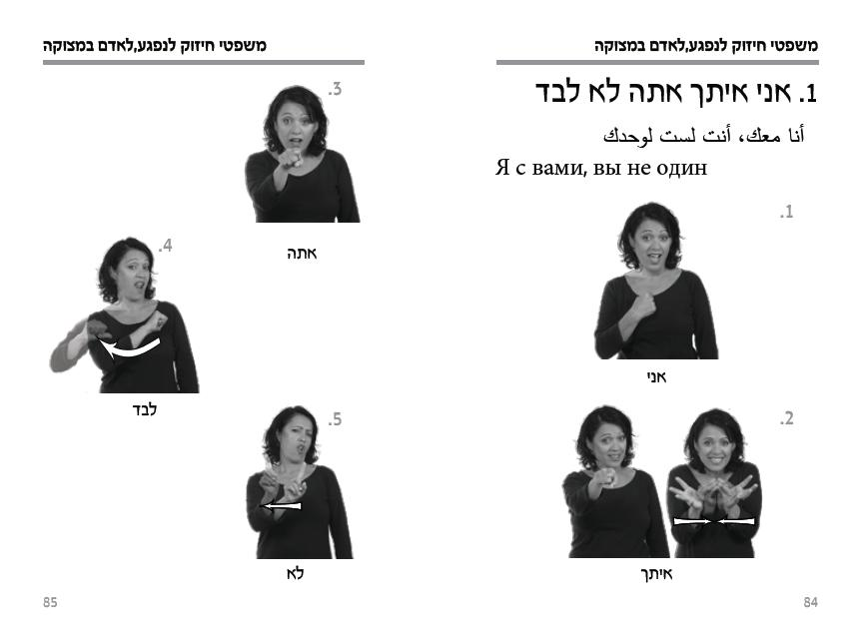
Support sentences for people in distress
I am
With you
You are not alone

Slide 10
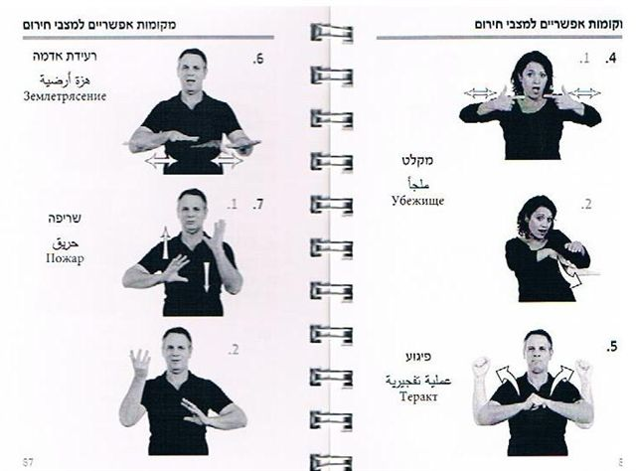
Emergencies
Earthquake
Shelter
Fire
Terror action

Slide 11
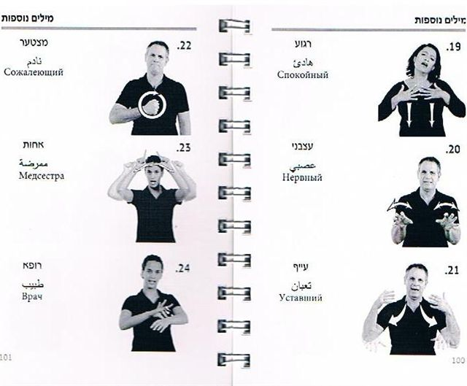
Additional words
Sorry
Calm
Anxious
Nurse
Tired
Doctor

Slide 12
The Israel Trauma Coalition is developing comprehensive guidelines for the hearing and sight impaired
as part of the EUNAD effort in Europe to create preparedness and response programs for special needs populations.
Psychosocial and health related needs during the cycle of emergency
Emergency preparedness and preparation activities
Psychosocial aftercare activities -mental health first aid activities that prevent traumatic process and promote resilience
Identifying best self-help behaviors during emergency

Slide 13

Status
A preliminary literature search
Focus group with representatives from key populations
Preparation of the questionnaire for the Delphi process
Conduction of the Delphi process,
Construction of the guidelines.

Slide 14
Key themes for
focus groups with hearing and sight impaired
individuals
and their relatives
Needs
Helpful coping strategies
Key difficulties during routine and emergency situations
The role of external people in coping and recovering from emergency;
Key issues in successful communication with emergency authorities;
Dos and don'ts in the communication with emergency authorities
Role of family members
Expectations from the authorities.
A semi structured questionnaire

Slide 15


Focus groups
date | No. of participants | Target population
July 9 2013 | 15 | Hearing impaired
July 23 2013 | 5 | Vision impaired
July 23 2013 | 16 | Hearing impaired
July 29 2013 | 8 | Vision impaired
31
13

Slide 16

Communication with the medical and security forces
One-on-one conversations works best
First responders have to:
Be patient
Maintain eye contact
Talk slowly and clearly
Use family members or neighbors in the communication process.
Key issues emerging from the focus group with the sight and hearing impaired:

Slide 17
Communication with a large number of people:
Large screen with sign language and subtitles
Speak slowly and clearly
Use of emergency beeper & video messages
Use of updated emergency contact list (municipal)
Simplification of language used by authorities
Community support
Key issues emerging from the focus group with the sight and hearing impaired:

Slide 18

Mobility
Ability to independently locate the nearest shelters
Notification of location of supplies in case of emergency
Delivery of supplies
Key issues emerging from focus groups with the visually impaired:
Knowing about an emergency
Notification by the CERT- Neighborhood emergency team

Slide 19
Recommendations
Preparedness is key to coping
Psycho-education is key to preparedness
Comprehensive municipal list of special needs population
A unit assigned for people with special needs.
Call line
Technological Aids
Smartphone technology
Conversation manuals

Slide 20
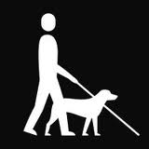
Next steps
A preliminary literature search
Focus groups with representatives from key populations
Preparation of the questionnaire for the Delphi process
Conduction of the Delphi process,
Construction of the guidelines.

Slide 21

Thank you for
your Attention
www.israeltraumacoalition.org
Talia Levanon
Ruvie Rogel

