Slide 1

Crisis, Disaster and Trauma in UK Emergency Services
Dr Noreen Tehrani
Noreen.Tehrani@noreentehrani.com

Slide 2
My background and role
Occupational Health Psychologist
  Counselling, health, coaching, trauma
Work with organisations to help victims of traumatic stress
Dealt with major UK incidents including:
  Shoreham Air Crash, Rail Crashes, Didcot power station, major flooding
  Terrorist attacks on Manchester Arena, Westminster, London Bridge, 9/11, 7/7
Other traumatising exposure including:
  Child abuse, undercover officers, Family Liaison, Counter terrorism, violence against police, hangings cot death etc

Slide 3
Disaster Management
Failures to integrate psychology into planning for disasters
Early Interventions
  Trauma focussed (e.g. debriefing)
  Support focussed (e.g. psychological first aid)
  Need for triage screening – duty of care
  Trauma focussed therapies
    TF-CBT
    EMDR
Evaluation
  Difficulties in setting up
  Need for “real world” research methodologies
  7/7 study for London bombings

Slide 4
Working with Emergency Services
Dealing with day to day traumatisation
  Situational
  Personal
Dealing with major incidents
  Plans
  Capacities
  Resilience
Organisational need
  Dealing with day to day business and the disaster
  Handling the unexpected
  Keeping responders at work

Slide 5
The outcomes of work related stress & trauma in police (Gershon et al. 2009)
Organisational stress and trauma is implicated in increased levels of:
  Depression
  Anxiety
  Burnout
  Somatisation
  Traumatic stress
  High blood pressure
  Spousal abuse
  Aggression
  Alcohol abuse
  Increased absence levels

Slide 6
Different roles different risks
Public Protection
  e.g. Child Protection, Visor, Forensic Examiners
Firearms
Undercover/ Surveillance officers
Roads Policing
Contact Centre
Hostage negotiators
Family Liaison

Slide 7
Comparisons between different policing groups
Clinical Symptom | On-line Child Abuse (n=371) | Child Abuse (n=362) | Firearms Officers (n= 174) | Police Negotiator (n= 464) | Roads Policing (n=100) | Family Liaison Officers (n106) | General Public
Anxiety | 23% | 29% | 3% | 24% | 20% | 25% | 3.5%
Depression | 15% | 30% | 5% | 27% | 19% | 30% | 8-12%
PTSD | 17% | 13% | 0% | 13% | 29% | 8% | 3%
Burnout | 13% | 26% | 1% | 26% | 35% | 22% | NA
Secondary Trauma | 15% | 23% | 6% | 17% | 10% | 18% | NA

Slide 8
HSE Risk Control Cycle
1. Identify the risks
2. Who might be harmed?
3. Evaluate the level of risk
4. Reduce the risk
5. Record, Monitor Review

Slide 9
Role Risk Assessment - Child Protection
Situational Factor | Higher Impact (5) | Lower Impact (1)
1. Involvement | Regularly exposed to extreme abuse to babies, young children or extremely vulnerable people | Seldom exposed to any extreme abuse to babies, children or the vulnerable
2. Exposure | Deals with sexual or serious physical abuse of children or other vulnerable people every day without any significant break | Exposed to the abuse of children or other vulnerable people less than once a month
3. Engagement | Direct contact with offenders or victims: face to face, on the internet | Indirect contact with offenders and victims
4. Pressure | Extreme volumes of work with little control over timescales | Manageable workloads
5. Safeguarding | Carries a major responsibility for the safeguarding of children or other vulnerable people | Does not carry significant safeguarding responsibilities
6. Prosecution | Carries the major responsibility for initiating prosecutions including giving evidence in court | No responsibility for dealing with prosecutions
7. Team working | A lone worker who is isolated in their working location with no opportunities for teamwork | Works in a supportive team with regular contact and gatherings
8.Autonomy | Works within a strict schedule with little opportunity to vary their working patterns | Has autonomy and able to make decisions on work undertaken, feels trusted
9. Security/safety | The work involves a need to maintain a high level of security. A risk to being personally identified by offenders or others | No major security issues, is able to talk about work to family and friends
10. Media | The work requires a high level of contact with the media to talk about the work undertaken | No exposure to the media

Slide 10
Who might be harmed by a traumatic exposure?
Personal Risk Assessment
  Individual trauma related factors
    E.g. Meaning of trauma, self blame/guilt, level of exposure, intensity of exposure, duration of exposure
  Temporary risk factors
    Pregnancy, bereavement, physical health, relationship issues
  Pre-deployment checklist for specialist roles
    E.g. FLO, body recovery

Slide 11
Post Incident Personal Risk Assessment
Personal Factor | Higher Impact (5) | Lower Impact (1)
1. Impact on colleague or friend | Very close friend or colleague was harmed or injured in trauma | No personal relationships involved
2. Feelings of guilt/self-blame | Feelings of responsibility or blame for a negative outcome | No feelings of guilt or responsibility, did a good job
3. Level of exposure to trauma | Exposure to a major trauma scene involving major death and disrupted bodies | Not exposed to any major death scenes
4. Duration of exposure | Exposed to trauma for more than ten hours | Not exposed to trauma scene for more than 3-4 hours
5. Exposure to injured people experiencing pain | Responsible for rescuing injured and dying people from a traumatic event | No exposure to the injured or dying
6. Exposure to families of the dead | Responsible of giving death message to families | No contact with the bereaved families
7. Potential for investigation by PSD/IPCC/HSE | Has been referred to an investigatory body relating to actions at traumatic event | Not referred to investigatory body
8. Organisational Support | Actions of management increased level of distress | Provided with good organisational recognition and support
9. Social Support | Isolated from team and not provided with any social support (gardening leave) | Part of a supportive team that has been able to provide mutual support
10. Personal circumstances | Has recently experienced a distressing life event (e.g. Bereavement, divorce, mental health problem) | Is fit and healthy, no mental health problems

Slide 12
Analysis and Evaluation of Risk
Psychological Screening Questionnaires
  Reliability
  Validity
  Access to materials
  Competence
  Confidentiality
  Ethical standards
Risk Factors
  Personal background
  Clinical measures
  Personality
  Coping and Resilience

Slide 13
Screening Model
Questionnaire complete online
Initial Sort
OK
QA Check
Clinical Review
Marginal
Not ok
Structured Interview
Not ok
Psychological Assessment
Individual Report & Fitness Note
Structured Interview Report & Fitness Note
Opinions & Management Advice

Slide 14
Primary Trauma Score Distribution
Structured Interview
7.2%
Surveillance Screenings, n=1110

Slide 15
Secondary Trauma Score Distribution
Surveillance Screenings, n=1110

Slide 16
Anxiety and Depression
Depression
Surveillance Screenings, n=1110

Slide 17
Burnout Distribution
Burnout: 22% over threshold

Slide 18
Reduce the risk
Early interventions
  Demobilization/Defusing
  Debriefing/Trim
  Wellbeing sessions
Trauma training for supervisors
Trauma education for everyone
Longer term interventions
  OH assessments
  Trauma counselling/therapy
  NHS referral

Slide 19
Supervisor support
Wellbeing checklists
  Self assessment (personal stressors)
  Work assessment (work stressors)
Supervisor Interventions
  Demobilising and defusing after a trauma
  Problem assessment and action planning

Slide 20
Record, monitor and research
On-line system allows management information to be derived from collected data
Longitudinal data gathering
Rich data for research
Bench marking
Comparative analysis
  Teams, roles, locations, age, tenure etc

Slide 21
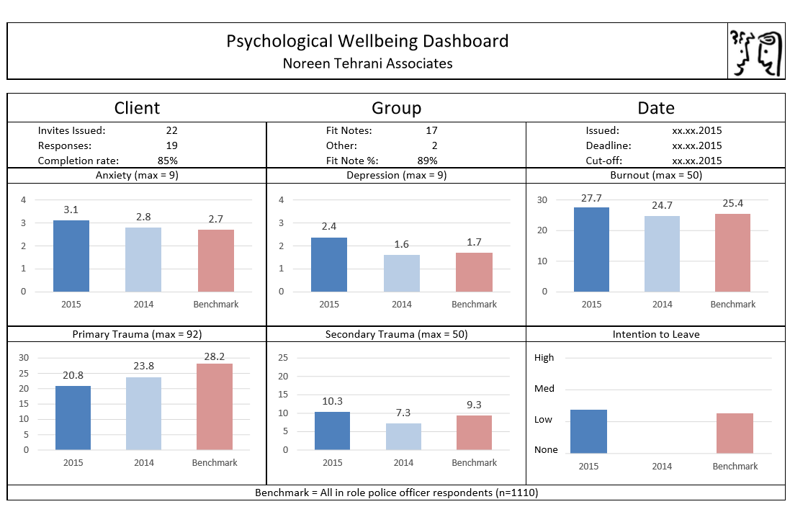
Screening Dashboard

Slide 22
Lifestyle issues

Slide 23
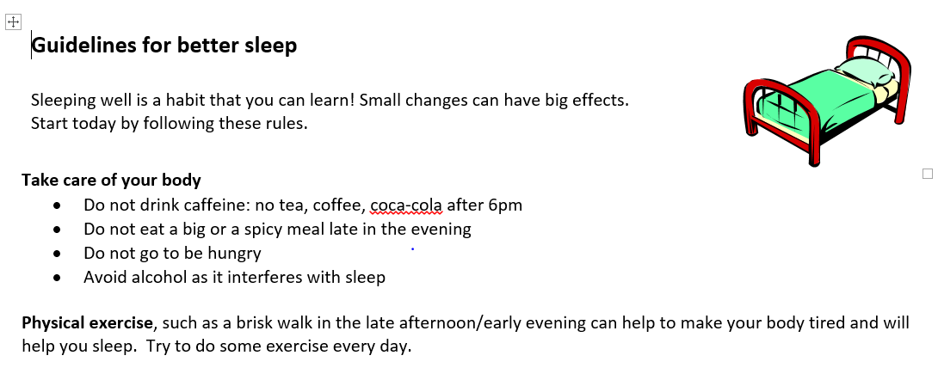
Information Handouts
How are handouts delivered?
How is the impact of the information programme assessed?
Poor lifestyle is correlated - 7% are rated poor on Sleep (<5 hours) AND EITHER Caffeine OR Exercise. Poor sleepers are also much more likely to have no Interests outside work.

Slide 24
What next
More management information:
  Use the data to monitor interventions
    Training, education, procedures, shift patterns, organisational change
  Compare teams, forces
    Benchmarking, resource planning
  Improve recruitment
    Selection criteria, training

Slide 25
Questions

