Slide 1



"NicE’S children"
Psychotherapic program for children, victims of the Nice tragedy.
Congress of Prague
October 20th 2017
Dr. Dominique Szepielak
Head of Psychologue French Association of terrorism victims department

Slide 2
Congress of Prague
October 20th 2017
NICE : 2016 JULY 14TH
Terrorism attack
86 deaths
458 injured peoples
3 000 children were present
Victims of 29 nationalities
Dr. Dominique Szepielak
Head of Psychologue French Association of terrorism victims department

Slide 3
Congress of Prague
October 20th 2017
Psychotherapeutic program for young children
MIMOSA Program
First Time huge Number of children impacted
Dr. Dominique Szepielak
Head of Psychologue French Association of terrorism victims department

Slide 4
Congress of Prague
October 20th 2017
Symptoms :
Disturbed sleep
Emotional instability
Concentrations difficulties at school
Nightmares
Agressive behavior
Memory impairment
Dr. Dominique Szepielak
Head of Psychologue French Association of terrorism victims department

Slide 5
Congress of Prague
October 20th 2017
Mimosa Project :
-5 days program with different workshops,
Meeting with parents,
Evaluation by hospital and psychotherapeutic institutions,
Assessment with Zulliger (Rorschach type test), at the begining and at the end.
Dr. Dominique Szepielak
Head of Psychologue French Association of terrorism victims department

Slide 6
Congress of Prague
October 20th 2017
Mimosa Project :
Results…
Dr. Dominique Szepielak
Head of Psychologue French Association of terrorism victims department

Slide 7
Congress of Prague
October 20th 2017
Mimosa Project :
During the program:
- From the third day, the parents observed that their children could finally sleep alone and had less restless nights, otherwise the children were more peaceful and less turbulent.
Dr. Dominique Szepielak
Head of Psychologue French Association of terrorism victims department

Slide 8
Congress of Prague
October 20th 2017
Mimosa Project :
After the program:
- The institutions in charge of the regular psychotherapeutic follow-up observe a better and a possibility to give a new breath to the psychotherapy.
- Schools observed more concentration, less agitation and better investment in school tasks among children.
- The parents observed a return to dialogue, an opportunity to talk about the traumatic event and less agitation.
- The test / retest showed that 100% of the children had left the dissociation.
Dr. Dominique Szepielak
Head of Psychologue French Association of terrorism victims department

Slide 9
Congress of Prague
October 20th 2017
Mimosa Project :
Today :
We are still in touch with the parents and initiating meetings to follow those children’evolution.
Dr. Dominique Szepielak
Head of Psychologue French Association of terrorism victims department

Slide 10
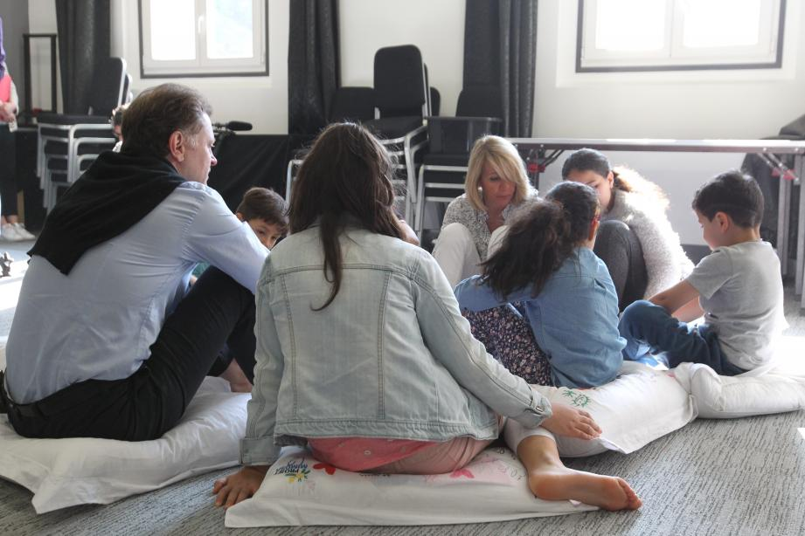
Congress of Prague
October 20th 2017
Mimosa Project :
Thank you very much for the opportunity to address you today, and for your attention.
Dr. Dominique Szepielak
Head of Psychologue French Association of terrorism victims department

