Slide 1

EARTHQUAKES: THE ROLE OF AN EMDR EARLY INTERVENTION
Lucia Formenti
EMDR Europe Association
Center for Research in Psychotraumatology – Milan

Slide 2
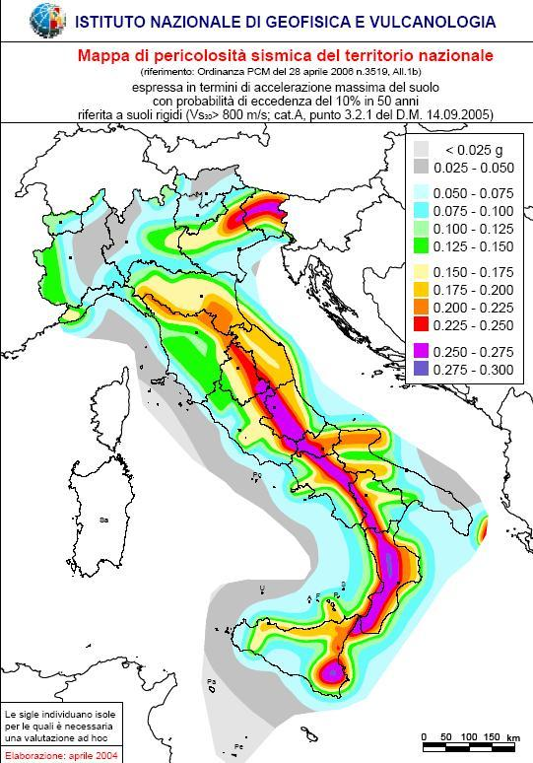
ITALY– MANY AREAS OF SEISMIC HAZARDS
Over the past 15 years, Italy has been hit by several earthquakes.
The Italian EMDR Association has been asked to intervene to help the victims to recover from extreme stress reactions.
Notes:
Italy has a medium-high seismic hazard (due to the frequency and intensity of phenomena), very high vulnerability (due to the fragility of building, infrastructural, industrial, production and service assets) and an extremely high exposure (due to population density and its historical, artistic and monumental heritage that is one of its kind in the world). The peninsula therefore has a high seismic risk, in terms of victims, damage to buildings and direct and indirect costs expected after an earthquake.
For over 15 years, a network of EMDR therapsits working pro bono jump into action to deliver EMDR early intervention and ongoing treatment to survivors (adults and children) and has since then worked to raise awareness within institutions and agencies involved with populations exposed to extreme stress.
We hope that by sharing the story of what we did, other professional organizations that plan disaster relief outreach will benefit from our experience.

Slide 3
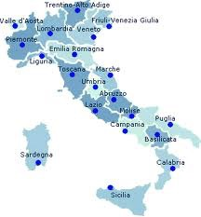
EMDR ASSOCIATION IN THE FIELD- EARTHQUAKES IN ITALY
Emilia, 2012
Amatrice-Norcia,2016
L’Aquila, 2009
San Giuliano, 2002

Slide 4
THE OVERALL GOAL OF EEI IN POST DISASTER:
Immediately reduce the intensity, duration, and number of acute stress symptoms, enabling survivors to move forward with their lives and be free of the trauma they experienced.
Notes:
EMDR may offer a relatively brief treatment specialising in the adaptive processing of trauma mem- ories. Studies show that after EMDR processing trauma memories are distanced. They are less vivid or emotionally evocative and the trauma memory can be viewed calmly.
Memory reconsolidation is the only known form of neuroplasticity capable of deleting an emotional learning.
In emdr memory reconsolidation is evident because:
- there is no longer reactivation. No more emotional reaction to the memory, cues or triggers that formerly did so or by other stressful situations (SUD=0)
Symptom cessation. Behaviours, emotions, somatics or thoughts that were expression of emotional reactions dissappear permanently
Results maintenance.

Slide 5
Policy Planning: Who Requires EMDR Early Intervention?
Exposure groups may be those who nearly escaped death, are injured, are family members of the deceased and/or have witnessed a catastrophic event (i.e. rescue workers).
Yet, EEI recipients should be those who are in sufficient distress to require treatment, not only those who receive a formal diagnosis.
PTSD prevalence can be expected in the first year after disasters, within exposure groups.
Notes:
Given the effectiveness of EMDR in treating symptoms of disaster survivrso, for policy planning and clinical intervention purposes the focus should not be based only on formal diagnoses, but on who is in sufficient distress to require treatment.
Available information is sufficient to suggest plausible ranges of PTSD prevalence that can be expected in the first year after disasters, within exposure groups.

Slide 6
EMDR Early Interventions (EEI) in Post-Disaster
Early EMDR interventions (EEI) are for those clients involved in a recent traumatic event.
The memory of recent trauma differs from that of a more distant trauma:
more fragmented
unconsolidated
less integrated into a coherent, narrative sequence of events
Notes:
The memory of recent trauma differs from that of a more distant trauma in that it tends to be more fragmented or unconsolidated and less integrated into a coherent, narrative sequence of events or theme cluster (Shapiro, Francine, 2001) (Shapiro, Elan, 2008).
“brief MDR intervention can be extremely beneﬁcial for immediately reducing the intensity, duration, and number of acute stress symptoms, most notably intrusive phenomena,

Slide 7
The goal is not to erase the memories of negative emotional experiences, but to process them, unlocking the neural connections that contain these memories: this is also called memory reconsolidation.

Slide 8
Ways of reprocessing during EMDR sessions
Resolution of sensorial fragments, that remain «trapped» in the memory in a disfunctional way (smells, sounds, etc.). Once these are desensitized, the level of disturbance falls to zero
Cognitive changes in people’s perspective: «I can protect myself», «I can count on me», «I am stronger that what I thought». Their point of view broadens and guilt diminishes
Focusing and recognizing what they had done during the earthquake
Switching from a feeling of not having control to a belief of having had control

Slide 9
EMDR EI POST - DISASTER INTERVENTIONS PROVIDE:
Outreaching
Critical Incident Stress Orientation (CISO)
Psychoeducation
Psychological support for rescue workers
Provide treatment to survivors with:
EMDR Group sessions
EMDR Individual sessions
Notes:
survivors’ displacement, the number of subjects, and other issues

Slide 10
EMDR OUTREACH PROGRAM PARTNERS
Governments at a sub-national and local level (municipalities)
School administrations
Civil society and non-governmental organizations
Civil Defense Administration
Military Red Cross
Notes:
EMDR NAs collaborates with many partners in emergency and disaster risk management, including governments at national, sub-national and local levels, international organizations, multilateral and bilateral agencies, civil society, and non-government organizations, research institutions and universities.

Slide 11

EMDR OUTREACH
A CENTRAL MOTIVATON:
PREVENTION AND THE LONG TERM COSTS OF TRAUMA
Notes:
One of the greatest challenges to the field of traumatic stress has been the observation that many individuals who coped at the time of their traumatic exposure become unwell at a later date
The mechanism that causes the progressive escalation of symptoms with the passage of time leading to delayed expression of post-traumatic stress disorder (PTSD) involves the process of sensitization and kindling.
It is therefore best to plan prevention policies, rather than to set goals to treat distress

Slide 12
EEI Protocols
EMDR integrative group treatment protocol (EMDR-IGTP):
It has been developed for use in mass disasters with large numbers of victims and few clinicians, with limited possibility of individual intervention.
Recent Traumatic Episode Protocol (individual sessions):
It is a comprehensive current trauma-focused protocol suitable for emergency settings with limited resources and time: it focuses on a progressive desensitization of the target memory.

Slide 13
Advantages of EMDR Early Intervention (EEI)
Brief intervention, rapid treatment effects
Psycho-physiological de-arousal response – decreases imagery/distress
Can be delivered on consecutive days (no homework required)
Prevents accumulation of trauma-memories
May strengthen resilience, important for on-going situations (economic factor)
Prevention: when there are ASD symptoms evidence, PTSD or other disorders may still develop as a delayed expression months or years later or after subsequent exposures to trauma
Majority of trauma-exposed victims with symptoms will not seek treatment

Slide 14

Earthquakes in Emilia (2012) and Amatrice (2016/17), Italy

Slide 15
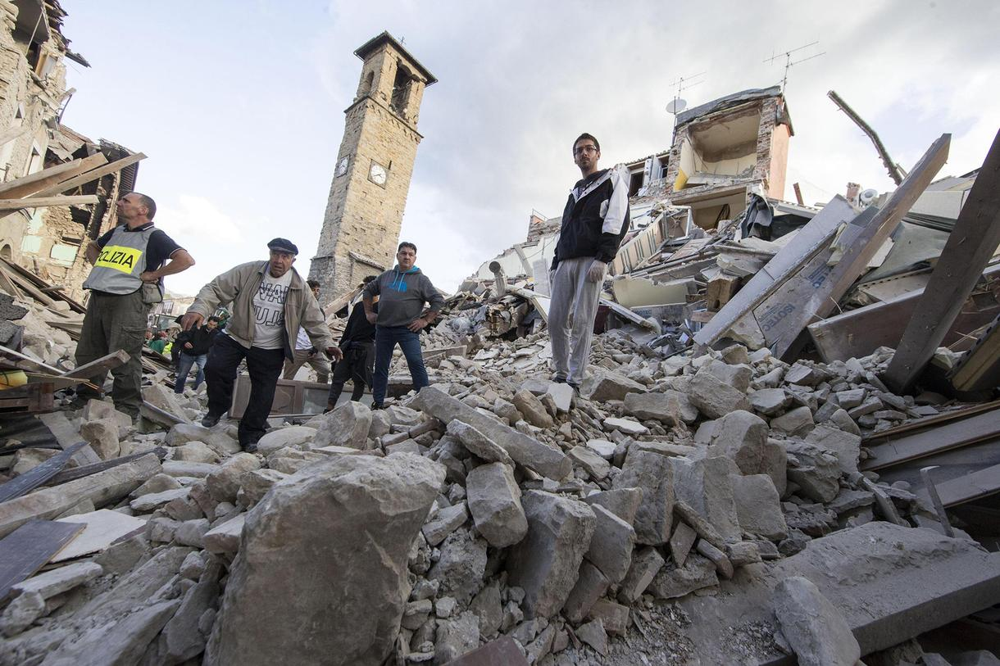
1.
EMILIA: WHAT HAPPENED
Two earthquakes of 5.9 Richter scale magnitude hit the Emilia region affecting 36% of the area.
A retrospective study evaluated the effects of EMDR therapy.
.
Notes:
Many survivors were relocated in tents within the urban context.
The local Mental Health Service continued to provide care in tents within a camp.
The unit aimed at bringing relief to the residents and to the emergency service personnel, providing active listening to victims, residents and rescuers.
The EMDR R-TEP was provided to all 529 survivors formally assessed with consideration for their physical, psychological and social needs before receiving EMDR specific intervention.assessed possible current psychopharmacological treatment, current mental state and degree of anxiety, depression or rritable/aggressive/disorganized behavior.
Particpants were placed either in the ET or LT group.
In addition, a possible time dependent effect was tested.
Conditions in the tent citis, ethical and organiational constraints precluded to enrol individuals in a research trial (lack of appropriately trained personnel, laco f reources, …)

Slide 16
EMILIA: EMDR OUTREACH AND TREATMENT STUDY
Objective:
Examine the effect of EMDR in reducing PTSD symptoms in early treated survivors (ET) compared with a wait-list control group (late treated LT).
Method:
529 adult participants with ASD and PTSD symptoms were allocated respectively to experimental group Early Treatment (n=239) or wait-list control group Late Treatment (n=290).
The main outcome measures were the IES-R at posttreatment (ET) and pretreatment (LT), 4-week follow-up. A time-dependent effect was also tested.
ET had been treated with EMDR R-TEP within 1 month after traumatic event (ASD assessed as per DSM IV).
LT were treated with EMDR R-TEP 1 month after the traumatic event (Acute PTSD assessed as per DSM-IV)
Notes:
Treatment:
The Recent Episode Protocol for Early Intervention (R-TEP) – 2 to 4 sessions provided by EMDR clinicians who had undergone formal training
Measures:
Triage form measuring sociodemographics, previous psychological/psychiatric history
Impact of Event Scale-R
Comparison of ET post-treatment IES-R scores with LT pre-treatment scores.

Slide 17
Comparison IES-R scores pre and post treatment (ET and LT)
 | Early | t | p-value | Later | t | p-value
avoidance-pre | 1.85 (0.80) |  |  | 1.95 (0.88)
avoidance-post | 1.27 (0.76) | 9.67 | 0.00 | 1.30 (0.85) | 12.87 | 0.00
intrusion-pre | 2.87 (0.96) |  |  | 2.83 (0.95)
intrusion-post | 1.37 (0.87) | 24.47 | 0.00 | 1.39 (0.92) | 24.05 | 0.00
hyperarousal-pre | 2.78 (0.73) |  |  | 2.75 (0.75)
hyperarousal-post | 1.20 (0.95) | 25.15 | 0.00 | 1.22 (0.96) | 25.38 | 0.00
ies-R total-pre | 54.31 (11.94) |  |  | 55.13 (12.28)
ies-R total-post | 27.91 (16.16) | 24.33 | 0.00 | 28.57 (17.94) | 24.38 | 0.00
Notes:
The comparison between post-treatment scores for the ET group with the pre-treatment scores of LT show a significant difference: lower scores for the early-treated group (p < 0.0001).

Slide 18
Results:
The comparison between post-treatment scores for the ET group with the pre-treatment scores of LT showed a significant difference: lower scores for the early-treated group (p < 0.0001).
Post-treatment IES-R average scores were significantly lower than baseline, in both groups. 65.8% of the ET and 64.02% of the LT group reported an IES-R total score <33.
Notes:
Participants with acute PTSD reported improvements, when able to return to their house, and when receiving a higher number of R-TEP sessions.
A higher number of R-TEP sessions were given to participants who presented more severe ASD and PTSD symptomatology, as well as irritable/aggressive or disorganized behaviour.
and not merely to the time lapse from the traumatic event

Slide 19
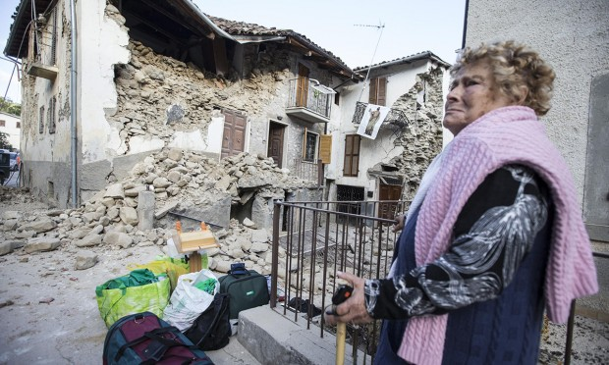
2.
NORCIA: WHAT HAPPENED
On August 24th 2016, an earthquake of magnitude 6.0 +/- 0.3 hit Central Italy, causing thousands of casualties with 300 dead.
Aftershocks are still ongoing.
Notes:
Previous earthquakes had already hit this area:
- in 1997 in Umbria and Marche of magnitude 6.1
- in 1979 in Norcia of magnitude 5.9
Up to today there have been 10.000 aftershocks ongoing seismic waves

Slide 20
NORCIA: EEI OUTREACH PROGRAM
Within 1 day after the disaster, a national plan was called for: the Psychological Order of Umbria and the Italian Civil Protection requested an EMDR Early Intervention:
Population census within major emergency shelters
Surveys assessing demographics (triage)
Information was given in written and verbal form describing typical posttraumatic stress reactions in adults and children and EMDR
Data collection, screening and assessing ASD prevalence, PTSD and factors related to ASD symptomatology among sheltered evacuees.
Notes:
The EMDR NA took immediate action with an outreach program based on the principles of emergency psychology, linking to the local municipalities, health and social services:
Survivors’ level of peri-trauma exposure, loss and injury, posttraumatic stress reactions, symptoms of anxiety and depression, somatic health problems, and sick leave, were assessed.
Lucia:
triage (Ministerial Decree of 2006 on the general criteria of psychosocial interventions in case of disasters and emergency)
1st session for registry, evaluation tests, self place, beginning of EMDR Protocol for Recent Events
from 2 to 6 sessions for reprocessing of traumatic memories through Recent Events Protocol and re-evaluation tests in the last session

Slide 21
EEI OUTREACH PROGRAM FROM AUGUST 2016 TO JUNE 2017
14 Critical Incident Stress Orientation sessions (psychoeducation)
29 EMDR group sessions with 120 participants;
100 EMDR group sessions in elementary and middle schools
1680 individual EMDR sessions (2 to 6)
Psychological counseling in high schools
145 EMDR clinicians and 65 colleagues from the Psychological Order volunteered throughout T1, T2, T3.
Notes:
CISO with parents and teachers for schools and with the whole community
Early Interventions Protocols
- R-TEP Protocol for recent events by Elan Shapiro for individuals
- IGTP Protocol by Jarero and Artigas
in the Operative Center and out-reaching

Slide 22
IN SUM
The EMDR Group Protocol and the R-TEP have been used with over 3.102 survivors, commencing 2 days after the earthquake.
Pre- and post-treatment data measures have been collected for research purposes.
In total, 9.282 hours of psychological treatment and specialized EMDR sessions were provided throughout 4 different regions of the seismic area.
Notes:
Treated survivors reported that EMDR was very useful and that they could feel a great relief after the group and individual sessions

Slide 23
All data collected yield preliminary positive findings in treated survivors.

Slide 24

THANKS!
Any questions?
You can find me at:
luciaf@emdritalia.it

